Slide 1
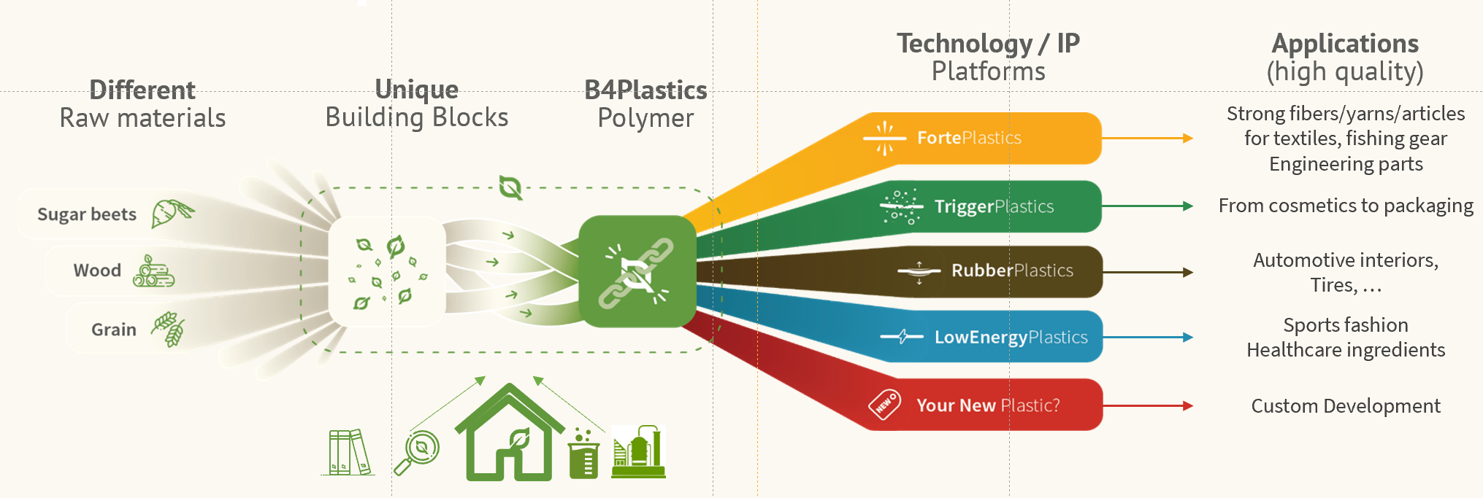

Polymer architects, rethinking, redesigning & disrupting this old fossil plastics industry by reaching new balances in functionality, ecology and cost.
Name:
B4Plastics
Problem
2020 : the world exceeded the average production of 1 Mio ton of plastic every day, over 50% of which is for single-use purposes
Plastics are getting under our skin increasing the needs of biobased, biodegradable & recyclable plastics.
Solution
Founded in:
Insert data
By striking the best balance between functionality, ecology and cost, we screen and breed customized bio-plastics & grow them from niche to bulk applications.
HQ:
Insert Location
Size:
Number of employee
Users & Markets
Typical buyers & users : 4 products to replace any kind of plastic for different Customer Cases : Chemical Industry and Consumer brands mainly
Market :
Target customer:
Insert Customer target
Competitive Advantage
Insert competitive advantage
Business model:
4 line description of your business model. (e.g: Software product with subscription per active user, implementation & consulting services
Team
Name of the CEO- CEO
Background:
Previous successes:
Market size:
Insert MS
Name II
Background:
Previous successes:
Financials
Contact:
Company email
Number of customer
Revenues Model
Needed

